Slide 1
Intermediate - Topic 1 – Logging On and What are Networks
Starter
Using the login details your teacher gives you, log in. Help others.
Make the following folders if you do not already have them:
Year 7, Year 8, Year 9
Inside Year 7 create a ‘Computing’ sub folder
Inside the ‘Computing’ folder make sub folders as follows:
Introduction
Small Basic
Spreadsheets
Theory

Slide 2
Logging On To The network
Username – 21SmithJ@croftonschool.co.uk.
Password – Make it something that you can remember. Write that password here ‘ ‘.
Password
Number
Uppercase letter
Lowercase letter
Symbol
Minimum 6 digits
How to save to your network area.
Read the Computing agreement in your planner and sign.

Slide 3
Intermediate - Topic 1 – Logging On and What are Networks
Foundation:
Up to and including 3
Your teacher will tell you’re your target grade:
3. Go to the Pupil Work area
> Year 7
> Computing
>Introduction
>Foundation, Intermediate or Advanced
Copy all of the documents in this area and paste them in your Introduction folder.
If you do not have a target grade choose the Intermediate documents.
Complete the following 4 slides:
Intermediate:
4 to 5
Advanced:
6 and above

Slide 4
Mastery Statements Level 4 – 5
Mastery 4
4(1) I can use presentation software to make a poster about the school Network.
4(2) I can make a poster for 11 – 12 year olds.
4(4) I can gain positive comments about my work.
4(4) I can gain ebi’s about my work.
4(4) I can improve my work.
Mastery 5
5(1) I can follow instructions and make a poster about the school network.
5(1) I can show how valuable a school network is.
5(2) I can show the good and bad of networking outside of school using examples.
5(3) I received some valuable www feedback.
5(3) I received some valuable ebi feedback.
5(3) I will improve my work and state what I did to improve it.

Slide 5

Produce a leaflet on the Network at Crofton School
Use the information in slides 6-8 to start a leaflet on the Network at Crofton School
Notes:
Make your leaflet for 11 – 12 year olds.
Write full sentences on the information.
You could add images.
You could work with someone else in the room using Office 365?
Gain 1 x www (what went well)
Gain 2 x ebi (even better if)
Act on the feedback.
Look at slide 4’s mastery statements for further guidance.
Star Network
A star network is ..
Network
A network is
Printing
To print at our school

Slide 6
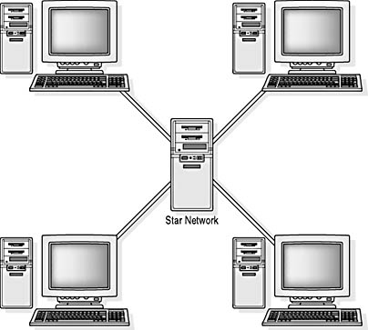
What Is A Network?
We use a star network

Slide 7
What is A Network?
All of the computers are connected to a central SERVER
Each computer is called a CLIENT
You save to the server, not the Client
This means you can get your work from any computer in the school
Printers are also connected to the server

Slide 8
How have I done?
 | Self Ass Y/N
A
B
C
D
E
Mastery 4
4(1) I used different software to make a poster about the school Network.
4(2) I made a poster for 11 – 12 year olds.
4(4) I got some www’s about my work.
4(4) I got some ebi’s about my work.
4(4) I improve my work making notes.
Mastery 5 is on the next slide.

Slide 9
How have I done?
 | Self Ass Y/N
A
B
C
D
E
F
Mastery 5
5(1) I followed instructions making a poster about the school network.
5(1) I showed how valuable a school network is.
5(2) I showed the good and bad ethics of networking outside of school using examples.
5(3) I made sure I received some valuable www feedback.
5(3) I made sure I received some valuable ebi feedback.
5(3) I was able to improve my work and state what I did to improve it.

